Slide 1
Independent and Dependent Variables
INDEPENDENT AND DEPENDENT VARIABLES ARE RELATED TO ONE ANOTHER.

Slide 2
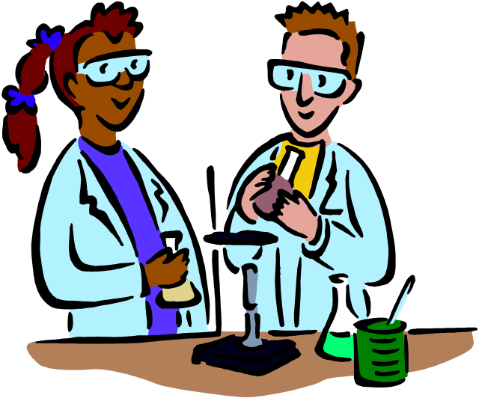
Independent Variable
The Independent part is what you, the experimenter, changes or enacts in order to do your experiment.

Slide 3
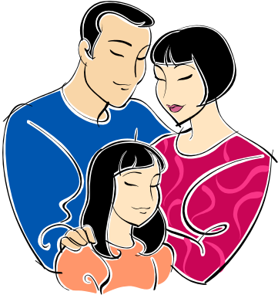
Dependent Variable
The dependent variable is what changes when the independent variable changes - the dependent variable depends on the outcome of the independent variable.

Slide 4

For instance: if you were measuring the growth rate of plants under full sunlight for 8 hours a day versus plants that only have 4 hours of full sunlight per day, the amount of time per day of full sunlight would be the independent variable - the variable that you control. The growth rate of the plants would be a dependent variable.

Slide 5
Independent | Dependent
Cause | Effect
Before | After
Input | Output
What you do | What happens

Slide 6
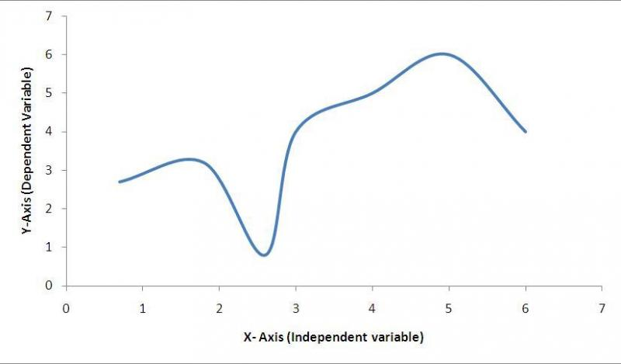
Independent = input a.k.a. x-value
Dependent = output a.k.a. y-value
Dependent variables go on y axis. Independent variables go on x axis.

Slide 7
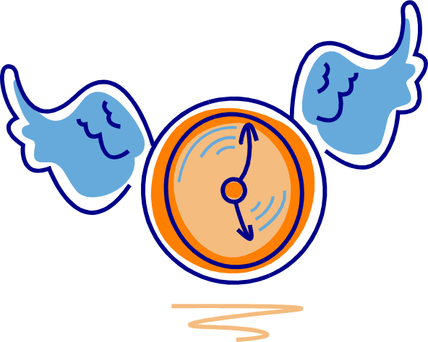
Time is almost always independent and that is why it nearly always on x axis. Time doesn't depend on anything in most experiments. But many things depend on it. Those will go on the y axis.

Slide 8
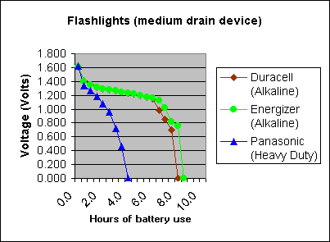
Independent? Dependent?

Slide 9
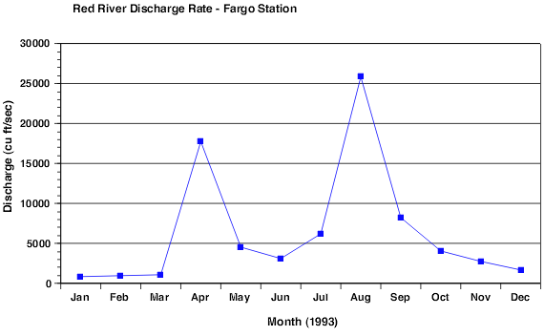
Independent? Dependent?

